Slide 1
Predicting Student Dropout Rates Using Supervised Machine Learning Classifiers
Semester: Fall 2023
Course: Data Mining
Professor: Juefei Yuan

Slide 2
Team Members
Name | Student Id
Shoaib Malik Mohammad | S02061048
Nikita Bajracharya | S02035604
Supriya Kunta | S02059954
Sadhana Aileni | S02059994
Keerthi Gopu | S02060023
Haritha Reddy Kyasaram | S02059755
Presentation link:

Slide 3
Table of Contents
Abstract
Introduction
Motivation
Methodology
Results
Discussion
Future Work
Conclusion

Slide 4
ABSTRACT
This study utilizes supervised machine learning classifiers, including Logistic Regression, Decision Trees, SVM, Random Forest, and K-Nearest Neighbors, to predict student dropout rates, addressing a critical educational challenge. A comprehensive dataset of student demographics and academic performance indicators was rigorously preprocessed and analyzed. The methodology involved detailed exploratory data analysis (EDA) and the application of multiple classifiers, focusing on balancing prediction accuracy and generalizability. Results showed significant predictive capabilities of the models, with some outperforming others in accuracy, precision, and recall. The study highlights the potential of machine learning in aiding educational institutions to identify and support at-risk students, suggesting future extension to diverse educational contexts and longitudinal data

Slide 5
INTRODUCTION
In recent years, the phenomenon of student dropout has emerged as a critical challenge in the educational landscape. This issue not only hinders the personal development of individuals but also poses significant social and economic implications. The complexity of factors leading to student dropout, ranging from personal and socio-economic backgrounds to academic performance, necessitates a nuanced approach to prediction and intervention. In this context, our study aims to employ supervised machine learning classifiers to predict student dropout rates, providing a novel approach to understanding and addressing this pressing issue.

Slide 6
MOTIVATION
This study is motivated by the significant social and educational impact of student dropouts, which affect individual futures and the broader economy. Recognizing the need for early identification of at-risk students, the study leverages advanced machine learning technologies to predict dropout rates more accurately than traditional methods. By applying various supervised machine learning classifiers, the research aims to aid educational institutions in effectively allocating resources and intervening to improve student outcomes. The study addresses a research gap in comprehensively using machine learning for predicting student dropouts, offering a data-driven approach to enhance educational program effectiveness.

Slide 7
Supervised Learning
Supervised learning involves training a machine learning model on a labeled dataset, where the outcome or target variable is already known.
The aim is to learn a mapping from inputs to outputs, to make predictions on new, unseen data based on the learned relationships.
Supervised learning was used to develop a predictive framework that can identify students at risk of dropping out. By training on historical data with known outcomes, the models learned to recognize patterns and indicators of dropout risk, which can be applied to new student data for early intervention and support strategies.

Slide 8
Logistic Regression
Type: Logistic Regression is a type of regression analysis used for predicting the outcome of a categorical dependent variable based on one or more predictor variables.
Application: In project, it's used for binary classification to predict whether a student will drop out (1) or not (0).
Mechanism: It estimates the probabilities using a logistic function, which is an S-shaped curve that can take any real-valued number and map it between 0 and 1.
Advantages: Simple to implement and interpret. It provides the probability for the outcome and works well for linearly separable data.
Limitations: Assumes a linear relationship between the independent variables and the log odds of the dependent variable. It can underperform with non-linear and complex relationships.

Slide 9
Random Forest
Type: Random Forest is an ensemble learning method, primarily used for classification and regression. It operates by constructing multiple decision trees during training.
Application: In predicting dropout rates, it can handle a mix of categorical and numerical features and can capture complex interactions and non-linearities.
Mechanism: It works by creating multiple decision trees on randomly selected data samples, then getting predictions from each tree and finally selecting the best solution through voting or averaging.
Advantages: Effective in high dimensional spaces, less likely to overfit than decision trees.
Limitations: Can be computationally intensive and less interpretable compared to simpler models like logistic regression.

Slide 10
Support Vector Machines (SVM)
Type: SVM is a powerful and versatile supervised machine learning algorithm, primarily used for classification and regression challenges.
Application: In study, SVM is likely used for classification to distinguish between students who are at risk of dropping out and those who are not.
Mechanism: SVM works by finding the hyperplane that best divides a dataset into classes. It’s effective in high dimensional spaces and uses kernel functions to handle non-linear data.
Advantages: Effective in high dimensional spaces and versatile due to the kernel trick.
Limitations: Requires careful tuning of the model parameters, can be less effective on very large data sets, and does not provide probability estimates directly.

Slide 11
K-Nearest Neighbors (KNN)
Type: KNN is a type of instance-based learning, or lazy learning, where the function is only approximated locally and all computation is deferred until function evaluation.
Application: In your project, KNN can be used to classify students as likely to drop out or not based on the similarity of their attributes to those of students whose outcomes are already known.
Mechanism: KNN works by finding the 'k' nearest data points in the dataset to a given new point and predicting the label based on the majority vote of its 'k' nearest neighbors.
Advantages: Simple to understand and implement, and no assumption about the structure of data is required, making it particularly useful for non-linear data.
Limitations: KNN can be very sensitive to the scale of data and irrelevant features. It also becomes significantly slower as the size of the data increases.

Slide 12
Decision Trees
Type: Decision Trees are a non-parametric supervised learning method used for classification and regression.
Application: In the context of predicting student dropouts, Decision Trees can be used to model the decisions made in classifying a student as likely to drop out based on various attributes.
Mechanism: It works by breaking down a dataset into smaller and smaller subsets while at the same time an associated decision tree is incrementally developed. The final result is a tree with decision nodes and leaf nodes.
Advantages: Easy to interpret and visualize, can handle both numerical and categorical data, and requires relatively little data preparation.
Limitations: Prone to overfitting, especially with complex trees. They can be unstable because small variations in data might result in a completely different tree being generated.

Slide 13
METHODOLOGY
Our methodology for predicting student dropout rates using supervised machine learning classifiers is designed to integrate comprehensive data analysis with robust model training and evaluation. This section outlines the key steps and techniques employed in our approach.

Slide 14
Data Collection and Preprocessing
Dataset Selection:
We utilized a dataset comprising various student demographics, academic performance indicators, and other relevant attributes that could influence dropout rates.
The dataset was sourced from kaggle, ensuring a diverse and representative sample of the student population.
Data Cleaning and Preprocessing:
The data underwent thorough cleaning, including handling missing values, correcting inconsistencies, and removing irrelevant features.
Categorical variables were transformed using one-hot encoding, and numerical features were standardized to ensure uniformity and improve model performance.

Slide 15
Exploratory Data Analysis (EDA)
Statistical Analysis:
We conducted a detailed statistical analysis to understand the distribution, mean, and variance of each feature in the dataset.
Correlation analysis was performed to identify potential relationships between different variables.
Visualization:
Various plots (e.g., histograms, bar charts, and scatter plots) were utilized to visualize the data, providing insights into the patterns and trends that could influence model design.

Slide 16
Model Selection and Training
Classifier Selection:
A range of supervised machine learning classifiers was chosen, including Logistic Regression, Decision Trees, Support Vector Machines (SVM), Random Forest, and K-Nearest Neighbors (KNN).
The selection was based on the ability of these classifiers to handle different types of data and their efficacy in classification tasks.
Training and Validation Split:
The dataset was split into training, validation, and test sets following the standard 70-15-15 ratio to ensure robust training and evaluation.
The training set was used to train the models, the validation set for tuning hyperparameters, and the test set for final evaluation.
Hyperparameter Tuning:
Techniques like GridSearchCV were employed to identify the optimal hyperparameters for each model, enhancing performance and preventing issues like overfitting.

Slide 17
Model Evaluation
Evaluation Metrics:
Accuracy, precision, recall, and the F1-score were used as the primary metrics to evaluate the performance of the classifiers.
The choice of these metrics ensured a comprehensive assessment of model performance, considering both the precision and recall.
Cross-Validation:
Cross-validation techniques were used to ensure the reliability and generalizability of the model performance.
Model Comparison:
The performance of different classifiers was compared to identify the most effective model for predicting student dropout rates.

Slide 18
4.5 Ethical Considerations
Data Privacy and Security:
We ensured that all data used complied with privacy and ethical standards, protecting student identities and sensitive information.
Bias and Fairness:
Measures were taken to identify and mitigate any biases in the dataset to ensure the fairness and objectivity of the models.

Slide 19
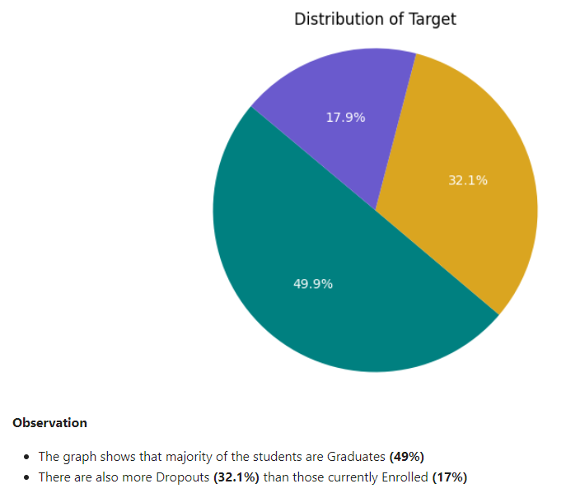
RESULTS

Slide 20
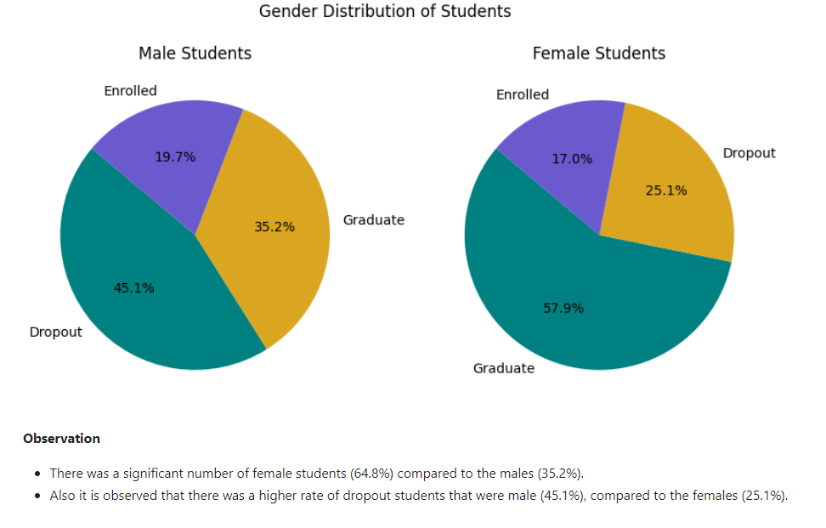
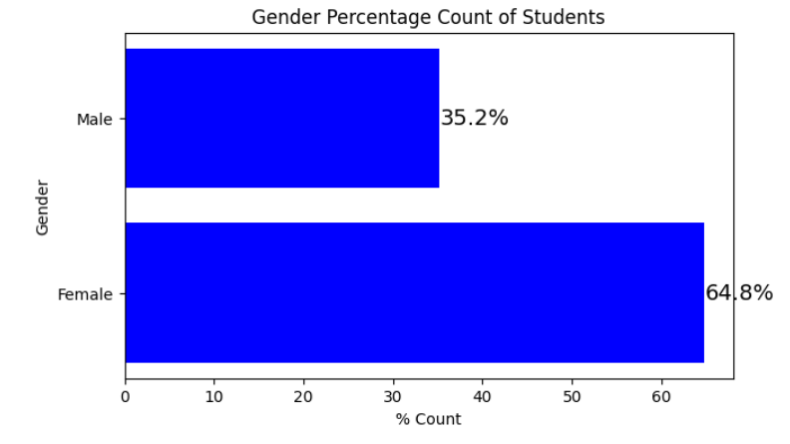

Slide 21
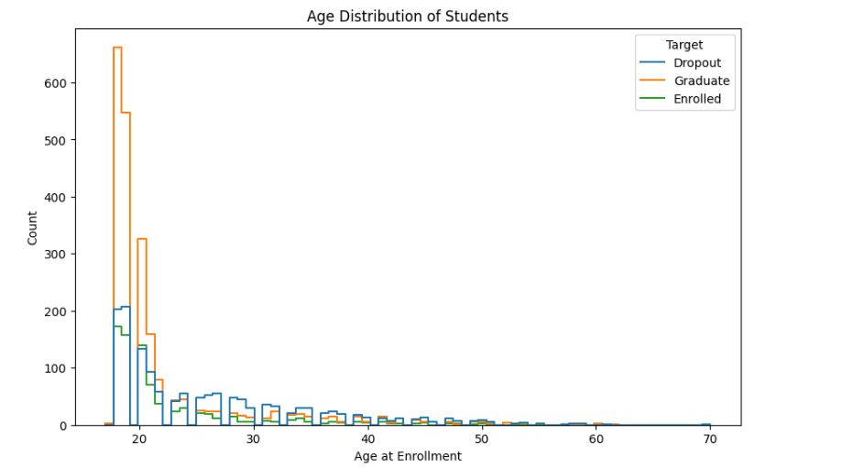

Slide 22
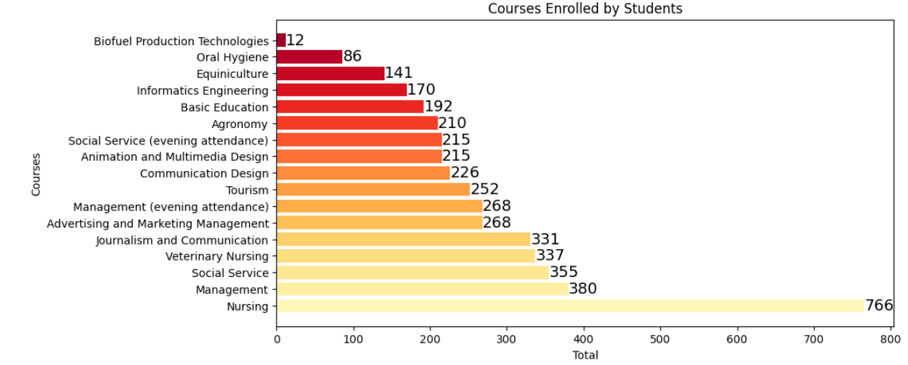
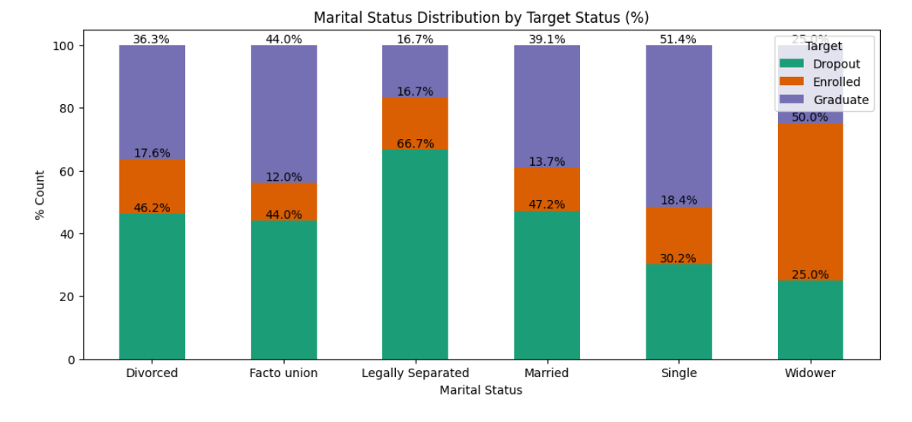

Slide 23
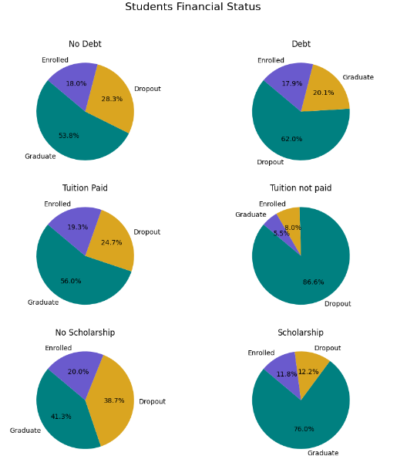

Slide 24
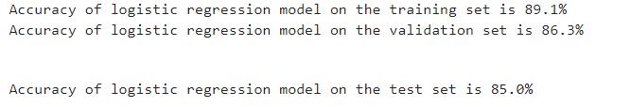
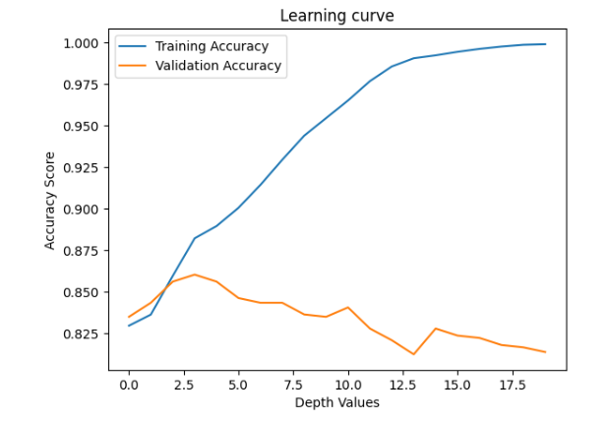
MODEL PERFORMANCE
Logistic Regression achieved an accuracy of 85%, with precision and recall metrics indicating strong performance in identifying true positives and negatives.

Slide 25
Decision Tree Classifier showed an accuracy of 84.6%. Despite its simplicity, it provided valuable insights into feature importance.
Support Vector Machine (SVM) displayed an accuracy of 84.7%. Its performance was particularly notable in classifying complex, non-linear relationships.
Random Forest Classifier recorded the highest accuracy of 84.9%. It demonstrated robustness against overfitting and provided an excellent balance between precision and recall.
K-Nearest Neighbors (KNN) had an accuracy of 78.1%, which was lower compared to other models but offered insights into the importance of feature scaling.

Slide 26
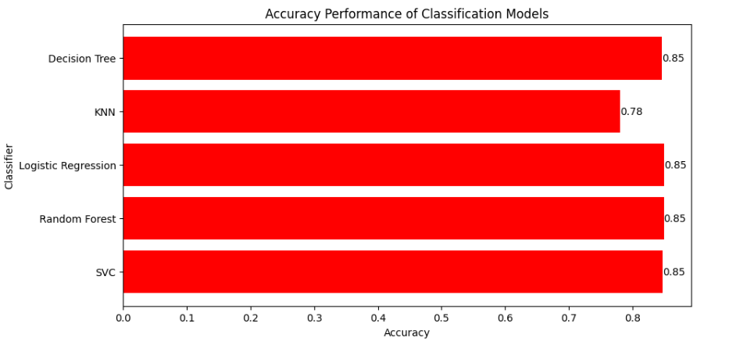

Slide 27
FUTURE WORK
Expanding Data ScopeDeep Learning Techniques
Personalized Intervention StrategiesCross-Institutional Validation
Ethical and Responsible Use of AI.
Integration with Educational Tools
Collaboration with Educational Researchers

Slide 28
CONCLUSION
This study highlights the effective use of supervised machine learning classifiers, particularly Random Forest, SVM, and Logistic Regression, in predicting student dropout rates, marking an advancement in using technology for educational insights. The approach benefits from comprehensive data analysis, diverse classifier use, and strong evaluation metrics, leading to models that align with educational theories and offer practical value. Key predictors identified include academic performance, attendance, and socio-economic background. Despite these strengths, limitations exist in the dataset's quality and potential biases, and the models' generalizability across different educational contexts needs further exploration.

Slide 29
References
Tinto, V. (1975). "Dropout from Higher Education: A Theoretical Synthesis of Recent Research." Review of Educational Research, 45(1), 89-125. [This classic paper presents a seminal theory on student dropout from higher education.]
Rumberger, R. W. (2001). "Why Students Drop Out of School and What Can Be Done." Paper prepared for the Conference, "Dropouts in America: How Severe is the Problem? What Do We Know about Intervention and Prevention?" Harvard University. [Rumberger provides a comprehensive analysis of factors leading to student dropout.]
Romero, C., & Ventura, S. (2007). "Educational Data Mining: A Survey from 1995 to 2005." Expert Systems with Applications, 33(1), 135-146. [This paper offers an overview of the application of data mining techniques in education.]
Bowers, A. J. (2010). "Analyzing the Longitudinal K-12 Grading Histories of Entire Cohorts of Students: Grades, Data-Driven Decision Making, Dropout Risk, and High-Stakes Testing." American Educational Research Journal, 47(6), 1174-1204. [A study that employs data-driven methods to analyze student grading histories.]
Lykourentzou, I., Giannoukos, I., Mpardis, G., Nikolopoulos, V., & Loumos, V. (2009). "Early and Dynamic Student Achievement Prediction in e-Learning Courses Using Neural Networks." Journal of the American Society for Information Science and Technology, 60(2), 372-380. [This paper demonstrates the use of neural networks in predicting student performance in e-learning settings.]
Slade, S., & Prinsloo, P. (2013). "Learning Analytics: Ethical Issues and Dilemmas." American Behavioral Scientist, 57(10), 1510-1529. [An important discussion on the ethical aspects of using learning analytics.]
Astin, A. W. (1993). "What Matters in College? Four Critical Years Revisited." San Francisco, CA: Jossey-Bass. [Astin's work provides insights into factors that matter in student success and retention in college.]
Bean, J. P. (1980). "Dropouts and Turnover: The Synthesis and Test of a Causal Model of Student Attrition." Research in Higher Education, 12(2), 155-187. [Bean's model offers an understanding of student attrition in higher education.]

Slide 30
THANK YOU

